Slide 1
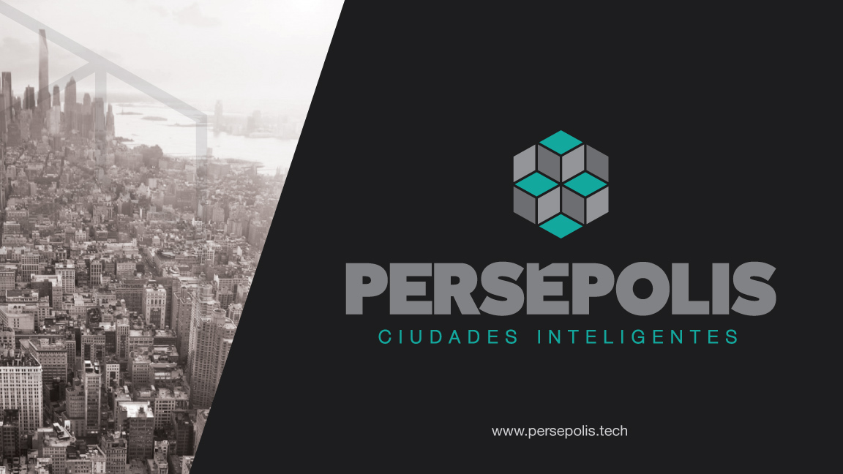

Slide 2
ABSTRACT
“A Smart City has the ability to make efficient, integrated and innovative management through physical and digital infrastructure, providing services to maximize impact for better life quality, making cities safer and sustainable in governance, economic, social and cultural matters”.

Slide 3
WIDE OPEN GOVERNMENT VISION
“Cities are living, complex and changing organisms. They require processes and flexible organizational structures, aligned with governments, institutions and citizens goals to make their selves changing agents to cover all subjects”.

Slide 4



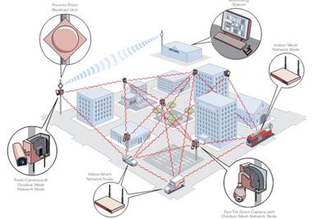








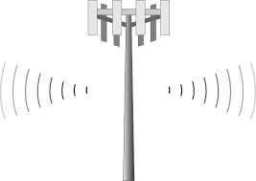







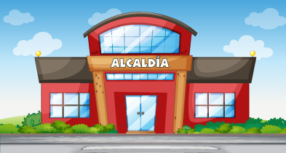







WIDE OPEN GOVERNMENT VISION
Utilities
Public Transportation
Health
Safe and Secutiry
Education and Culture
Urban Development
Public Governance
Sport and Recreation
Enviromental
C-IT
UTILITIES AND CITIZEN SERVICES (APPLICATIONS)
IT INFRASTRUCTURE
CIVIL INFRASTRUCTURE
ENVIROMENTAL

Slide 5

SOLUTION FOUNDATION
Established guidelines on business model are hierarchically organized as follows.
International Scope
SDO - SUSTAINABLE DEVELOPMENT OBJECTIVES
SDO
NDP
1
1
DDP
National Scope
1
MDP
NDP - NATIONAL DEVELOPMENT PLAN
- Modern Cities -
2
2
2
1
3
4
Department Scope
3
3
DDP - DEPARTMENTAL DEVELOPMENT PLAN
4
5
4
4
5
5
Local Scope
5
MDP - MUNICIPAL DEVELOPMENT PLAN

Slide 6
UNIFIED MODEL STRUCTURE
From our business model, smart cities are conceived as comprehensive and integrated solution, and not as an independent solution set.
Control Panel
Citi Management
Business
Intelligence
Impact Metrics
Result indicators
Big Data
Service Provision
Process indicators
Unified Solution
Connectivity (IoT)
Infrastructure
(Physical / Digital)
Structure indicators
Economy
Governance
Society
Environmental

Slide 7





SMART CITY HIGHWAY
The proposed evolution path for smart city.
1
6
Status Assessment
Evolution and Maintenance
2
Consulting Development
5
Implementation
4
Funding Source
3
City Model Structuring

Slide 8
PROJECT APPROBATION ISSUES IT-Programs:
Inadequate practices on project structure and formulation.
Absence of IT-Programs and strategic plans.
Disarticulation with national plans.
Deficiency knowledge of regulatory framework.
Poor precision of technological and scientific matters.
Lack of federal and long term objectives for better economical and social impact.

Slide 9
Better engagement for IT-Programs funded with government and international resources:
Overall IT-Programs application to all PDD's sectors to achieve a smart city:
Higher level of productivity and competitiveness.
Further development and global economy mindset.
Greater efficiency in the public management and better service provision to the citizen.
Increased quality life of citizens.

Slide 10
Better engagement for CTeI-TIC for smart cities
Identify macro situation of region, including a diagnostic on internal funding resource (royalties) and gap closure.
Training for territorial authorities relating to internal funding system (SGR).
Legal, technical, methodological and finance aid in project structure and formulation focused on institutions regards.
Support in the identification of priorized projects to pass along decision making organisms (OCAD).
Carry on working tables with city authorities for project program review .

Slide 11
Best support with IT-Programs to move forward Smart City
Project charting and structure according with national and territorial plans.
Project charting and structure: long term federal and integrated approach for better social and economical impact.
Funding sources management: government, international and privates.
Contract management.
Phases Implementation.
Contribute to the achievement of Departmental Development Plan goals.

Slide 12
IT-Programs for all city sectors related with Local Development Plan toward to Smart City
Security platform for cities.
Paper and documents platform.
Entrepreneurship and technology based enterprise (IT-Programs).
Open data.
Census database processing.

Slide 13
IT-Programs for all city sectors related with Local Development Plan toward to Smart City
Innovation round tables.
Research and Technology Development Centers.
Scientific, technological and R&D parks.
District Affairs Center: CAD
Justice Halls and coexistence centers.
E-government initiatives.

Slide 14
DELIVERABLES
Management and coordination model.
Strategical.
Structural.
Implementation.
Cultural.
Tech specifications.
Project’s technical specification priorized by Entities related with city’s verticals (Education, Health, Mobility, Environment, Security, etc.).

Slide 15
CONTACTOS
Boris Uzcátegui Morales
Persepolis Project Director
Cellular 3506673132
OyG Consulting S.A.S
Street 93 B No. 11A - 44 Office 301, Telephone: + 57 1 6912971
BOGOTA D.C., COLOMBIA

Slide 16


